Slide 1
On Heterogeneous Coded Distributed Computing
Mehrdad Kiamari ∗ , Chenwei Wang † and A. Salman Avestimehr ∗
GLOBECOM 2017

Slide 2
INTRODUCTION
SYSTEM MODEL AND MAIN RESULTS
THE ACHIEVABILITY OF THEOREM 1
CONVERSE OF THEOREM 1
ALGORITHM OF THE ACHIEVABILITY FOR THE GENERAL 𝐾 SERVER NODES
CONCLUSION

Slide 3
1. INTRODUCTION
In distributed computing networks different nodes have often different processing, storage, and communication capabilities. For example, Amazon EC2 [12] provides users with a wide selection of instance types with varying combinations of CPU, memory, storage, and bandwidth
the problem in heterogeneous systems appears to be much more challenging, because we have to deal with more parameters of the node-storage size for file allocation.
In addition, in homogeneous systems, the file allocation to achieve the minimum communication load turned out to be cyclically symmetric with node indices
本文的工作：
基于异构的文件分配(function 分配是同构的)，给出K=3时的文件分配和传输规则。
基于算法，给出K=3时的传输量公式，并证明最优性
K>3时未给出具体下界和上界，只是提供思路(线性规划)

Slide 4
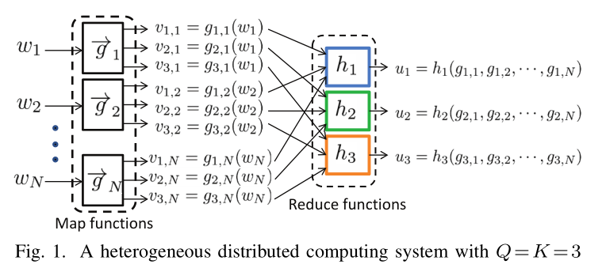


2. SYSTEM MODEL AND MAIN RESULTS
N个$文件w_{1},w_{2},w_{3},…,w_{N}∈𝔽_{2^{F}}$
Q=3个output functions${ φ}_{1},φ_{2},…,φ_{Q}:{{(𝔽}_{2^{F}})}^{N}→𝔽_{2^{T}}$
$ℳ_{k}⊆\{1,2,…,N\}$ 表示节点k包含的文件集合
$𝒲_{k}⊆\{1,2,…,Q\}$表示节点k包含的output function集合
考虑3个节点的异构网络
$\left|ℳ_{i}\right|≠\left|ℳ_{j}\right|$ $\left|𝒲_{i}\right|=\left|𝒲_{j}\right|=1$
最终目的，求Q个output functions
Map Phase
Shuffle Phase
Reduce Phase

Slide 5

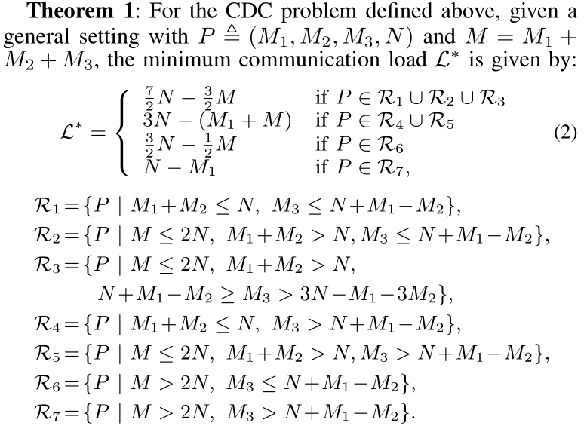
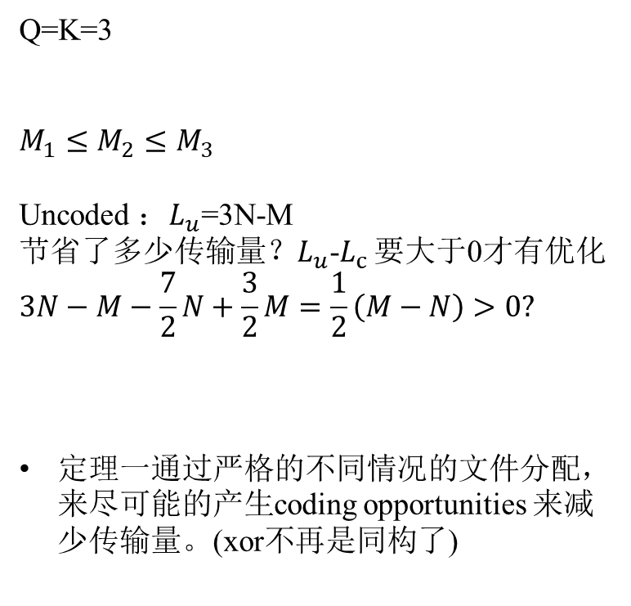
2. SYSTEM MODEL AND MAIN RESULTS
Q=K=3
$$M_{1}≤M_{2}≤M_{3}$$
Uncoded ：$L_{u}$=3N-M
节省了多少传输量？$L_{u}$-$L_{c}$ 要大于0才有优化
$$3N−M−\frac{7}{2}N+\frac{3}{2}M=\frac{1}{2}\left(M−N\right)>0?$$
定理一通过严格的不同情况的文件分配，来尽可能的产生coding opportunities 来减少传输量。(xor不再是同构了)

Slide 6
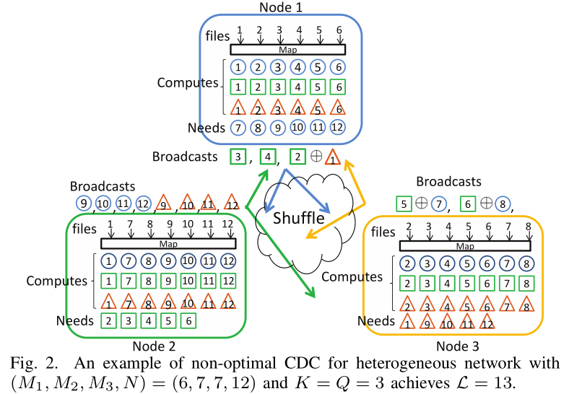
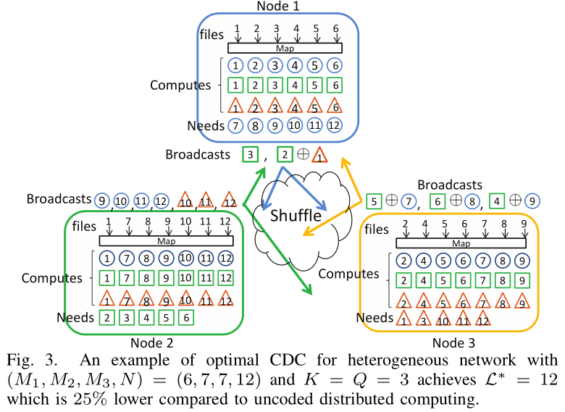
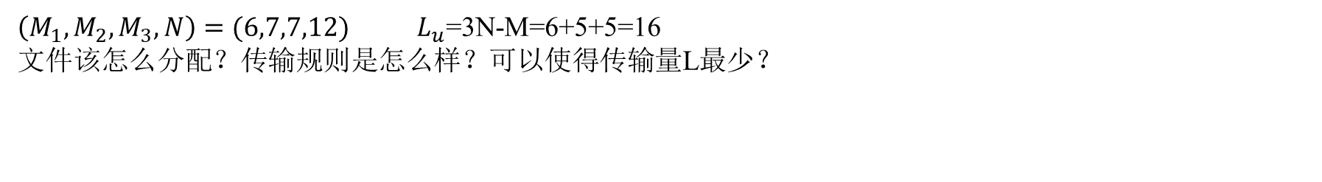
3. THE ACHIEVABILITY OF THEOREM 1(Example)
$\left(M_{1},M_{2},M_{3},N\right)=(6,7,7,12)$ ${ L}_{u}$=3N-M=6+5+5=16
文件该怎么分配？传输规则是怎么样？可以使得传输量L最少？
一种可行的文件分配
可以达到最优传输量的文件分配

Slide 7
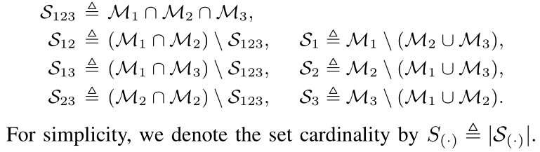
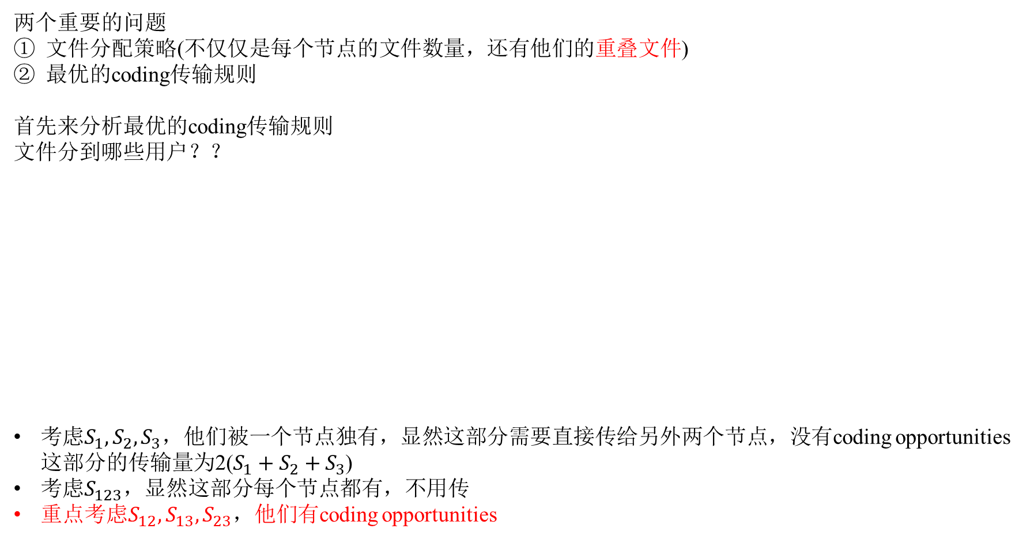
3. THE ACHIEVABILITY OF THEOREM 1(optimal coding scheme design)
两个重要的问题
文件分配策略(不仅仅是每个节点的文件数量，还有他们的重叠文件)
最优的coding传输规则
首先来分析最优的coding传输规则
文件分到哪些用户？？
考虑$S_{1},S_{2},S_{3}$，他们被一个节点独有，显然这部分需要直接传给另外两个节点，没有coding opportunities 这部分的传输量为2($S_{1}+S_{2}+S_{3}$)
考虑$S_{123}，$显然这部分每个节点都有，不用传
重点考虑$S_{12},S_{13},S_{23}$，他们有coding opportunities
显然他们是不相交的

Slide 8
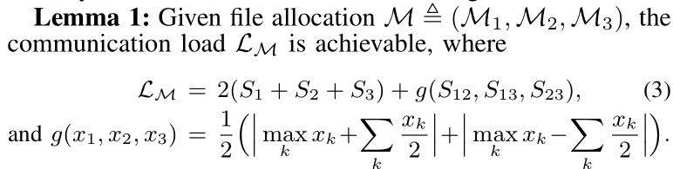
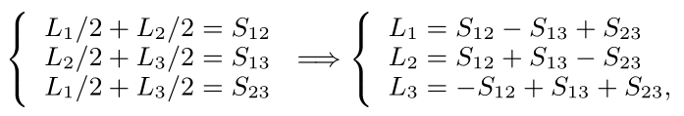
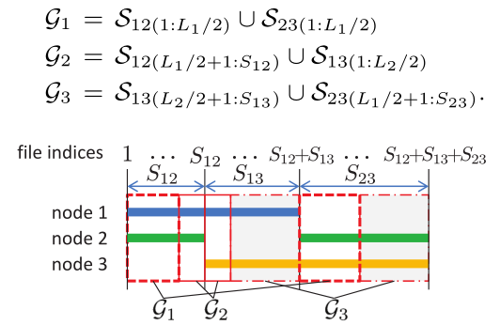
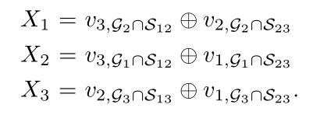

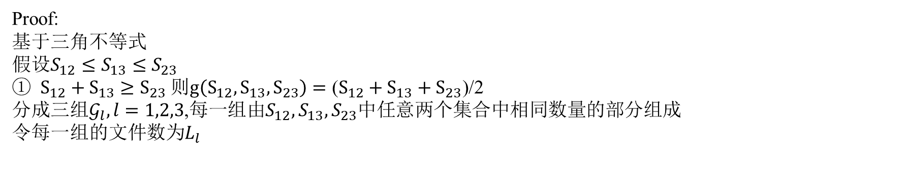
3. THE ACHIEVABILITY OF THEOREM 1(optimal coding scheme design)
重点考虑$S_{12},S_{13},S_{23}这部分$传输量
Proof:
基于三角不等式
假设$S_{12}≤S_{13}≤S_{23}$
$S_{12}+S_{13}≥S_{23}$ 则$g\left(S_{12},S_{13},S_{23}\right)=\text{(}S_{12}+S_{13}+S_{23}\text{)}\text{/2}$
分成三组$𝒢_{l},l=1,2,3$,每一组由$S_{12},S_{13},S_{23}$中任意两个集合中相同数量的部分组成
令每一组的文件数为$L_{l}$

Slide 9
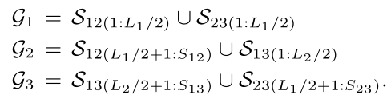
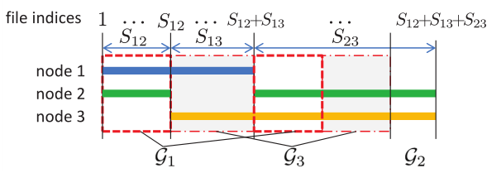
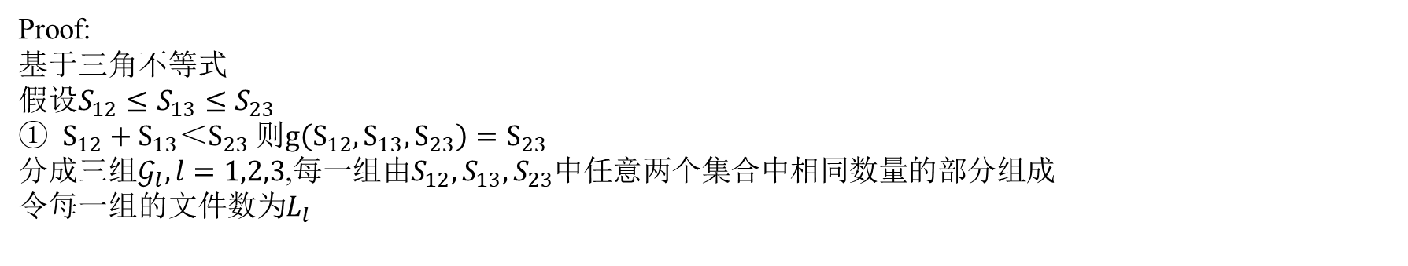
3. THE ACHIEVABILITY OF THEOREM 1(optimal coding scheme design)
重点考虑$S_{12},S_{13},S_{23}这部分$传输量
Proof:
基于三角不等式
假设$S_{12}≤S_{13}≤S_{23}$
$S_{12}+S_{13}＜S_{23}$ 则$g\left(S_{12},S_{13},S_{23}\right)=S_{23}$
分成三组$𝒢_{l},l=1,2,3$,每一组由$S_{12},S_{13},S_{23}$中任意两个集合中相同数量的部分组成
令每一组的文件数为$L_{l}$

Slide 10
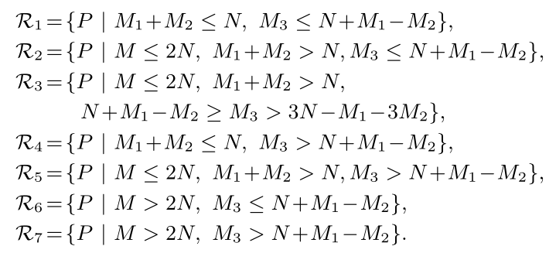

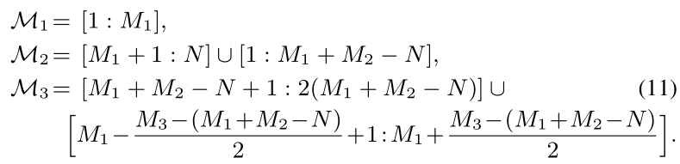
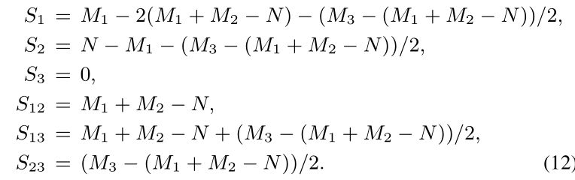
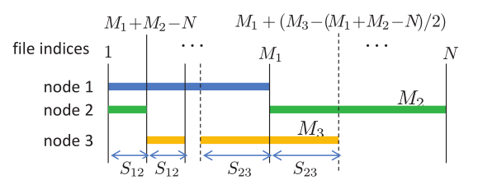
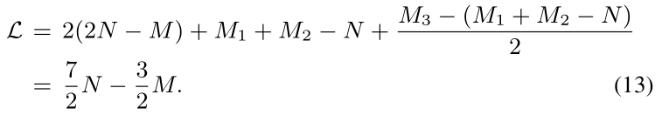

3. THE ACHIEVABILITY OF THEOREM (file allocation)
两个重要的问题
文件分配策略(不仅仅是每个节点的文件数量，还有他们的重叠部分)
最优的coding传输规则
证明$ℛ_{2},ℛ_{3},ℛ_{5}$

Slide 11

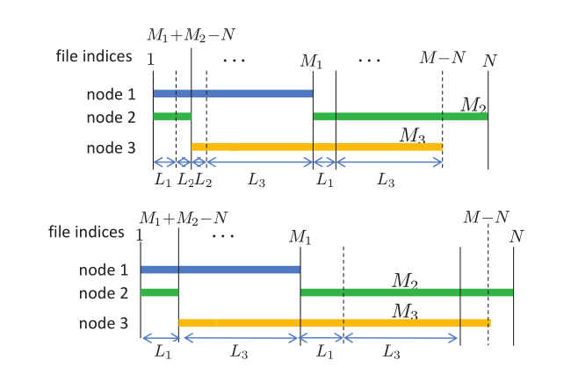
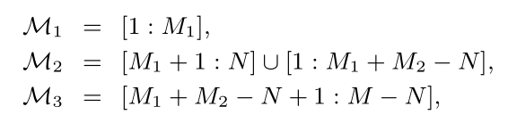
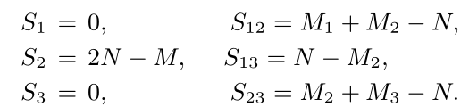
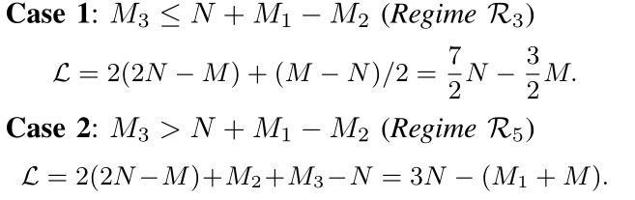
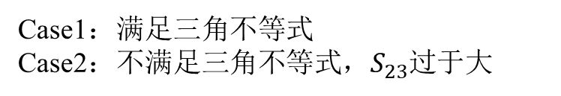
3. THE ACHIEVABILITY OF THEOREM (file allocation)
Case1：满足三角不等式
Case2：不满足三角不等式，$S_{23}$过于大

Slide 12

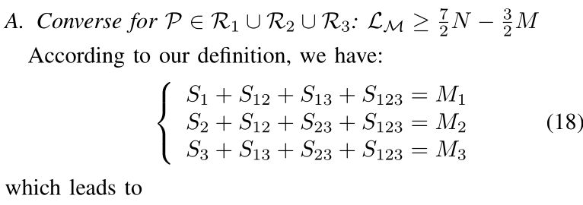


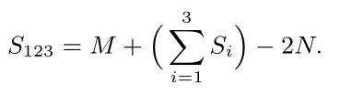
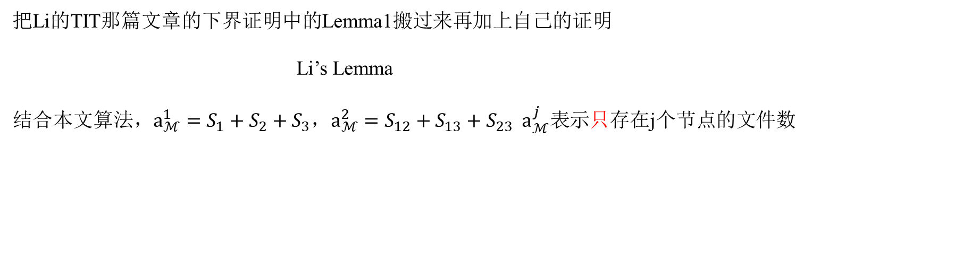

4. CONVERSE OF THEOREM 1($ℛ_{1},ℛ_{2},ℛ_{3}$)
把Li的TIT那篇文章的下界证明中的Lemma1搬过来再加上自己的证明
Li’s Lemma
结合本文算法，$a_{ℳ}^{1}=S_{1}+S_{2}+S_{3}$，$a_{ℳ}^{2}=S_{12}+S_{13}+S_{23}$ $a_{ℳ}^{j}表示$只存在j个节点的文件数
$$(M＜2N,S_{1}+S_{2}+S_{3}≥2N−M)$$

Slide 13
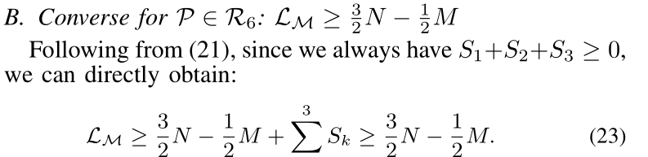
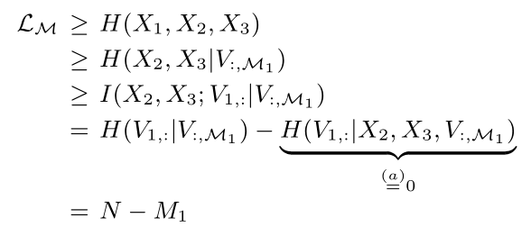
4. CONVERSE OF THEOREM 1($ℛ_{6},ℛ_{7}$)
本质上其实是cut-set bound
信息论的证明是想办法把中间值移到左边，把发送的数据X移到条件里面再化简

Slide 14
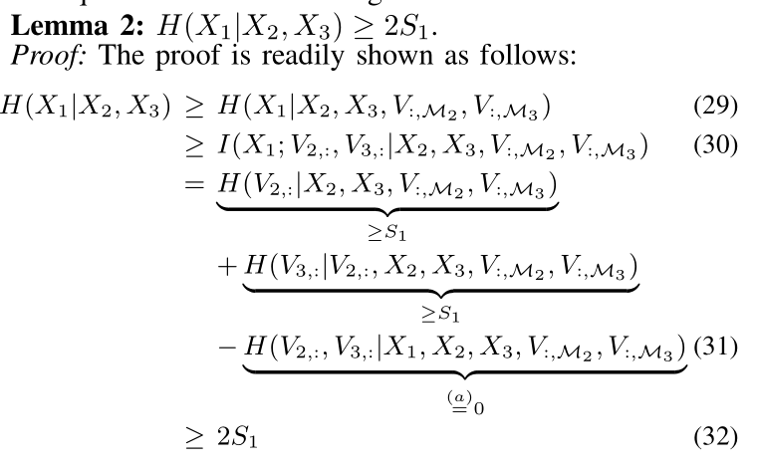
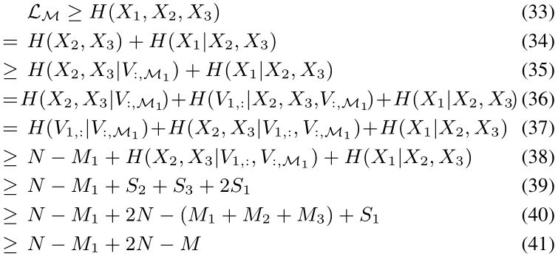
4. CONVERSE OF THEOREM 1($ℛ_{4},ℛ_{5}$)
很多地方从信息论到具体中间值传输量的转化都是基于cut-set bound

Slide 15
6. CONCLUSION
Conclusion
基于异构的文件分配(function 分配是同构的)，给出K=3时的文件分配和传输规则。
基于算法，给出K=3时的传输量公式，并证明最优性
K>3时未给出具体下界和上界，只是提供思路(线性规划)
Thinking
这篇文章的文件分配和重复量的图示对传输过程中的coding opportunities理解很有帮助
这篇文章只是考虑了三个节点就已经比较麻烦，且没有给出通用的文件分配和传输规则(上上周的文章给出了通用scheme)
Future Direction
An interesting future direction is the development of a unified coded computing method for heterogeneous systems that deals with both the bandwidth and straggler problems. Such a unified framework has been proposed for homogeneous systems in [16], but remains open for heterogeneous systems.

